Slide 1
ARM Organization & Implementation

Slide 2
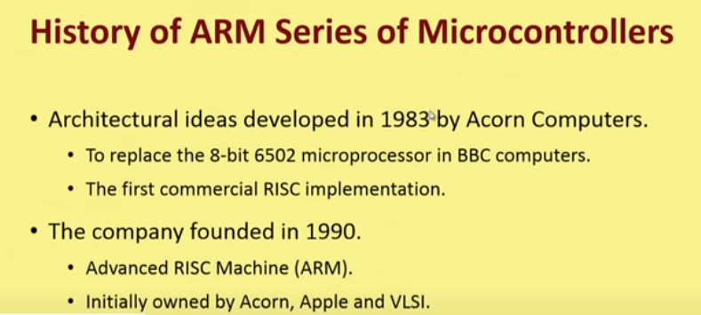

Slide 3
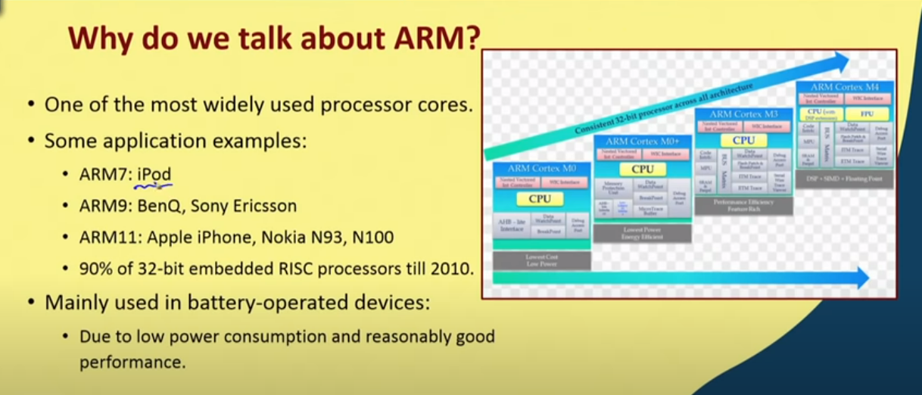

Slide 4
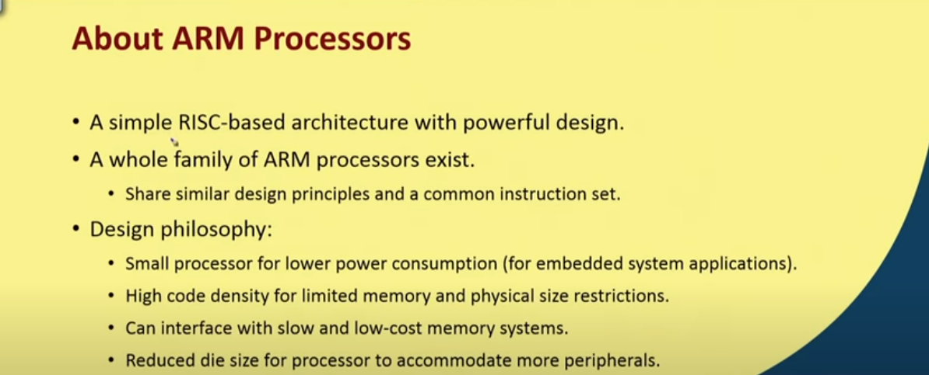

Slide 5
Byte Ordering
Byte ordering, or endianness, is another major architectural consideration.
If we have a two-byte integer, the integer may be stored so that the least significant byte is followed by the most significant byte or vice versa.
In little endian machines, the least significant byte is followed by the most significant byte.
Big endian machines store the most significant byte first (at the lower address).

Slide 6
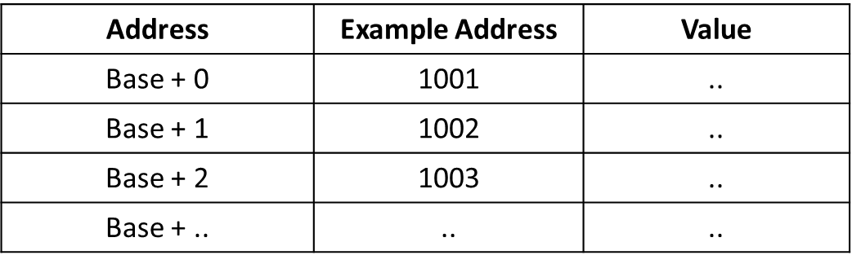
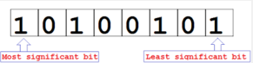
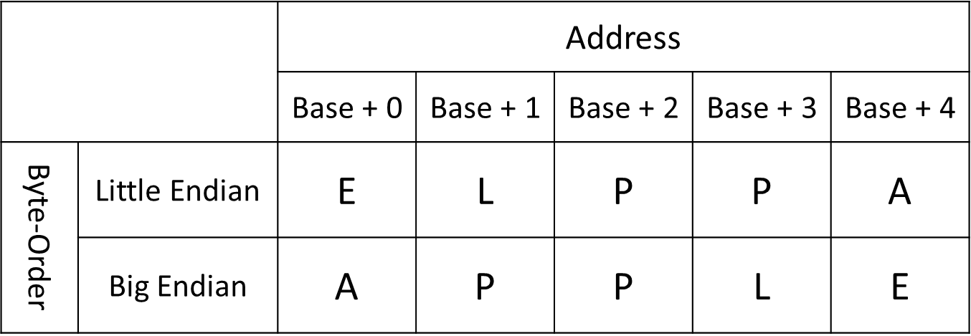
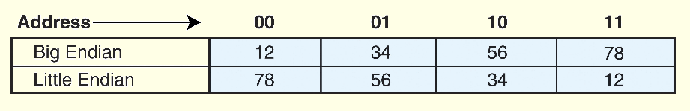
Ex. Represent the String
APPLE

Slide 7
Contd.,
Why is endianness so important?
Suppose you are storing int values to a file, then you send the file to a machine which uses the opposite endianness and read in the value.
You'll run into problems because of endianness. You'll read in reversed values that won't make sense.
Endianness is also a big issue when sending numbers over the network.
Again, if you send a value from a machine of one endianness to a machine of the opposite endianness, you'll have problems.
This is even worse over the network, because you might not be able to determine the endianness of the machine that sent you the data.

Slide 8
Contd.,
Where does this term "endian" come from? Jonathan Swift was a satirist (he poked fun at society through his writings).
His most famous book is "Gulliver's Travels", and he talks about how certain people prefer to eat their hard boiled eggs from the little end first (thus, little endian), while others prefer to eat from the big end (thus, big endians) and how this lead to various wars.

Slide 9
Contd.,
Endianness only makes sense when you want to break a large value (such as a word) into several small ones.
You must decide on an order to place it in memory. However, if you have a 32 bit register storing a 32 bit value, it makes no sense to talk about endianness.
The register is neither big endian nor little endian. It's just a register holding a 32 bit value.
The rightmost bit is the least significant bit, and the leftmost bit is the most significant bit.

Slide 10
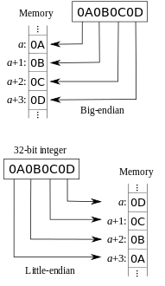
Contd.,
Big endian:
Is more natural.
The sign of the number can be determined by looking at the byte at address offset 0.
Strings and integers are stored in the same order.
Little endian:
Conversion from a 16-bit integer address to a 32-bit integer address does not require any arithmetic.

Slide 11
Contd.,
Examples of Little Endian
BMP
RTF
MSPaint
Examples of Big Endian
JPEG
Adobe Photoshop
MacPaint

Slide 12
Organization Vs. Architecture
Architecture
how various components in a computer are organized & the design aspect of a computer.
Describes users view of the computer
Eg: instruction set, visible registers, memory management table structures.
Computer Organization
is how features are implemented, typically hidden from the programmer. E.g. control signals, interfaces, memory technology etc.
I.e., describes the user-invisible implementation of architecture.
It is basically concerned with the way the hardware components operate and the way they are connected together to form the computer system.

Slide 13
Organization Vs. Architecture
Architecture refers to how various components in a computer are organized & the design aspect of a computer.
Computer Organization is how features are implemented, typically hidden from the programmer. E.g. control signals, interfaces, memory technology etc.
It is basically concerned with the way the hardware components operate and the way they are connected together to form the computer system.

Slide 14
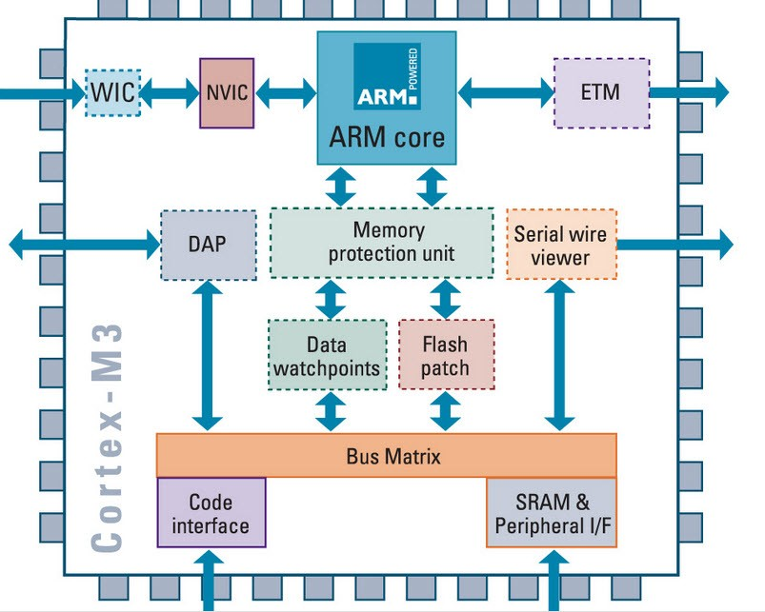
ARM Architecture
CORE== processing unit or computing engine
--this aspect is decided by the architecture, which represents basic design of processor.
Unique feature of ARM as a company == it designs the core and licenses this IP to others
This means that company does not ‘fabricate’ the chip, but sells only the design.
This design is taken by licensee, who may or maynot add more features to the design.
Different Ways of Selling IP: SOFT IP or Hard IP

Slide 15
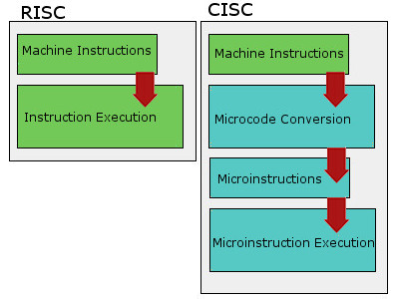
The Key To ARM Is RISC
ARM is an acronym which stands for Advanced RISC Machine. In the name is another acronym (yes, nested acronyms!) which stands for Reduced Instruction Set Computing.
RISC is, in its broadest form, a design philosophy for processors. It stems from a belief that a processor with a relatively simple instruction set will be more efficient than one which is more complex.
[The term originally came into use back in the 1980s with a research project called Berkeley RISC that investigated the possibilities of this approach to design and then created processors based on it].
All ARM processors are considered RISC designs, but this doesn’t mean much because RISC itself is simply an approach to design rather than a technological standard or processor architecture. Still, a basic understanding of RISC properly frames ARM.

Slide 16
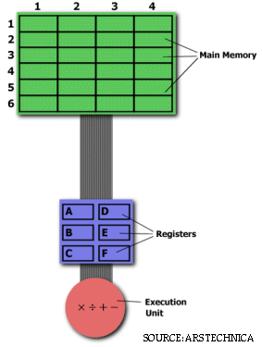
Contd., An Example.. Multiplying two numbers in memory
On the right is a diagram representing the storage scheme for a generic computer.
The main memory is divided into locations numbered from (row) 1: (column) 1 to (row) 6: (column) 4.
The execution unit is responsible for carrying out all computations.
However, the execution unit can only operate on data that has been loaded into one of the six registers (A, B, C, D, E, or F).
Let's say we want to find the product of two numbers - one stored in location 2:3 and another stored in location 5:2 - and then store the product back in the location 2:3.

Slide 17
Contd., THE CISC APPROACH
The primary goal of CISC architecture is to complete a task in as few lines of assembly as possible.
This is achieved by building processor hardware that is capable of understanding and executing a series of operations. For this particular task, a CISC processor would come prepared with a specific instruction (we'll call it "MULT")
MULT 2:3, 5:2
MULT is what is known as a "complex instruction.“
It operates directly on the computer's memory banks and does not require the programmer to explicitly call any loading or storing functions.
It closely resembles a command in a higher level language
When executed, this instruction loads the two values into separate registers, multiplies the operands in the execution unit, and then stores the product in the appropriate register. Thus, the entire task of multiplying two numbers can be completed with one instruction:
Advantages:
Because the length of the code is relatively short, very little RAM is required to store instructions.
The emphasis is put on building complex instructions directly into the hardware

Slide 18
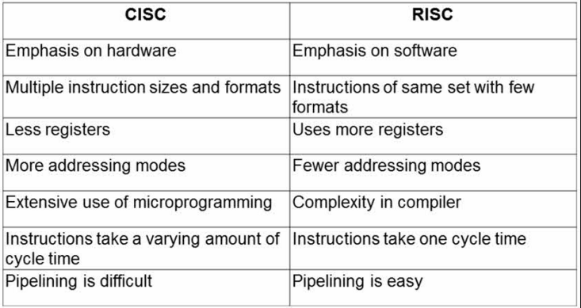
Summarize…

Slide 19
ARM’s Business Is Different
ARM refers to itself as an architecture, which can cause a misunderstanding when compared to Intel.
Intel gives every new chip design its own unique code and talks about each as a new architecture – even when there’s often many similarities and they all use the same instruction set (x86)
ARM, on the other hand, treats its designs as an unbroken family. Updates are still a part of the ARM architecture. They’re just given a new version number.
The trait that’s most relevant to consumers is not the micro-architecture (the physical design of the chip) but instead the instruction set.

Slide 20
The instruction set
is the basic set of capabilities and features a processor makes available to software.
It determines what arithmetic can be used, how cache should be allocated and the order in which instructions should be executed.
Software designed for one instruction set can’t be used on another unless it’s revised.
Micro-architectures and instruction sets
can’t be separated because the architecture is a physical expression of the instruction set.
This is why ARM-based processors tend to be small, efficient and relatively slow.
The simple instruction set requires a small, simple design with fewer transistors.
Transistors consume power and increase die size (which increases production cost), so having as few as possible is ideal when selecting a processor for a smart phone or tablet.

Slide 21
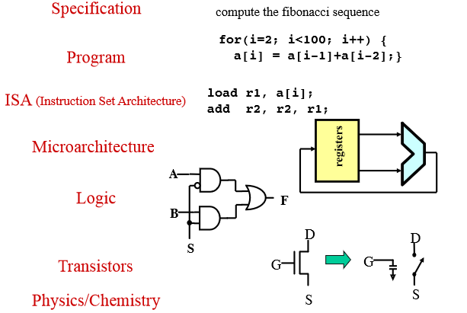
What is a computer system?

Slide 22
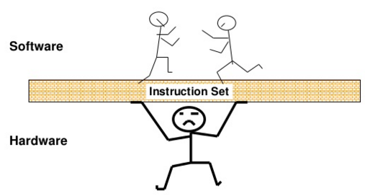
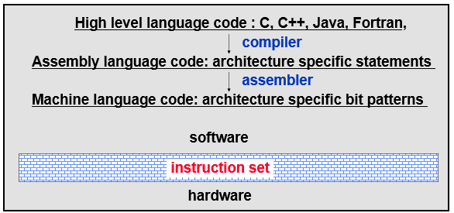
Instruction Set Architecture
Serves as an interface between software and hardware.
Provides a mechanism by which the software tells the hardware what should be done (i.e. instructs the hardware to do the right thing)

Slide 23
What is an instruction?
ADD A, B
Here we tell the microprocessor to add the contents of two registers A and B. That is it! This forms the baseline!
It is like you giving an order to your subordinate! It has to be obeyed!

Slide 24
What do instructions provide?
Which operation to perform – add r0, r1, r3 // operation code
Where to find the operand or operands – add r0, r1, r3 // source operands
Place to store result – add r0, r1, r3 // destination
Location of next instruction – add r0, r1, r3 br endloop

Slide 25
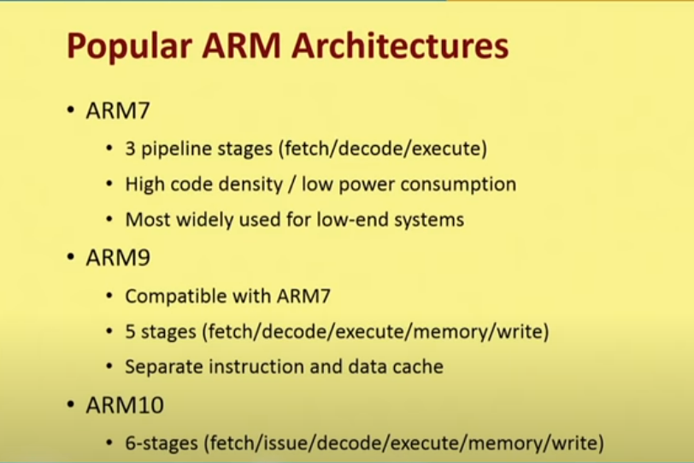

Slide 26
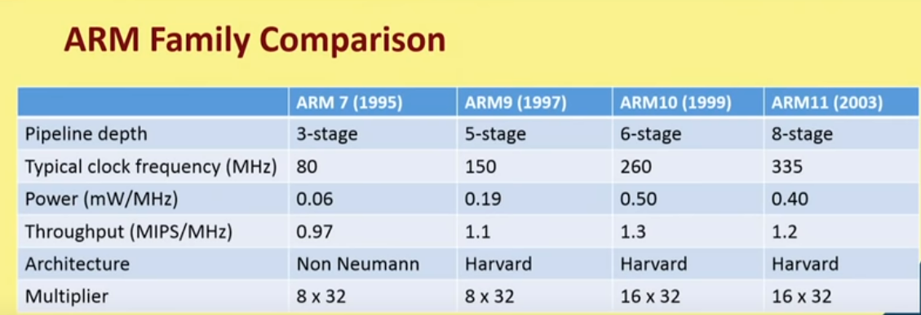

Slide 27
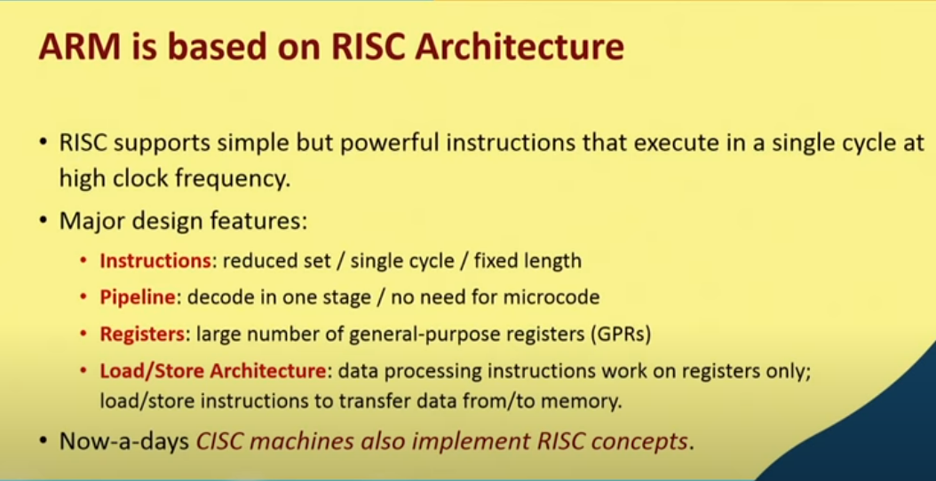

Slide 28
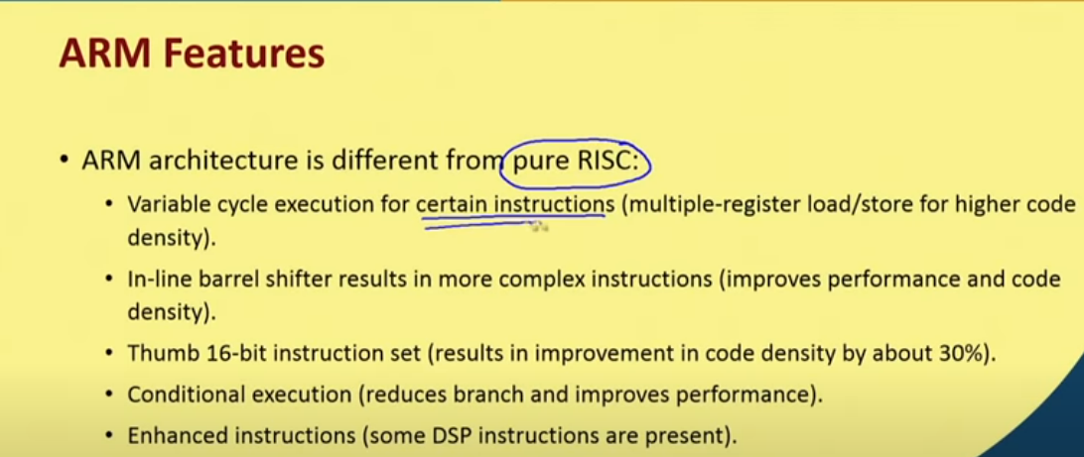

Slide 29
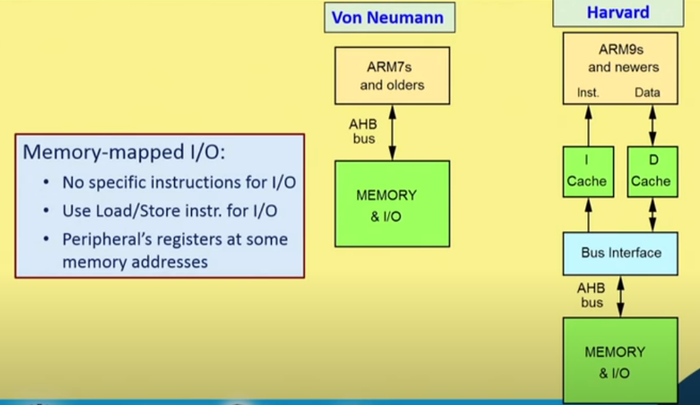

Slide 30
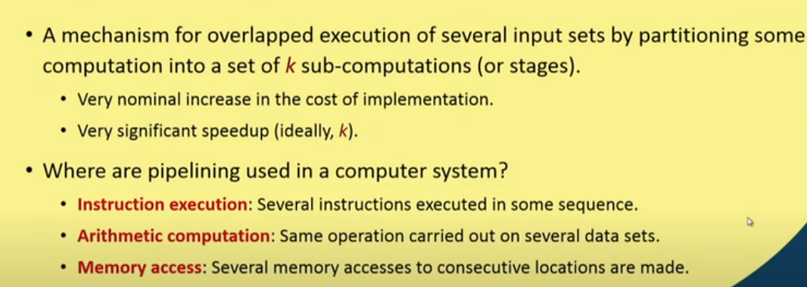

Slide 31
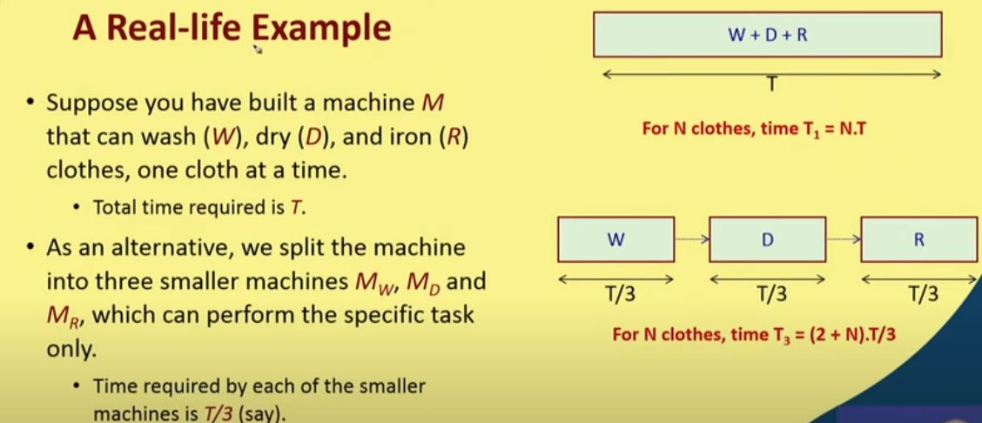

Slide 32
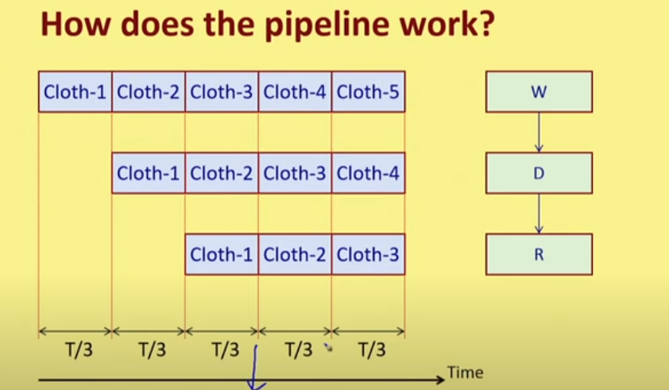
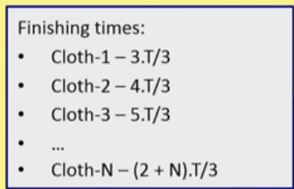

Slide 33
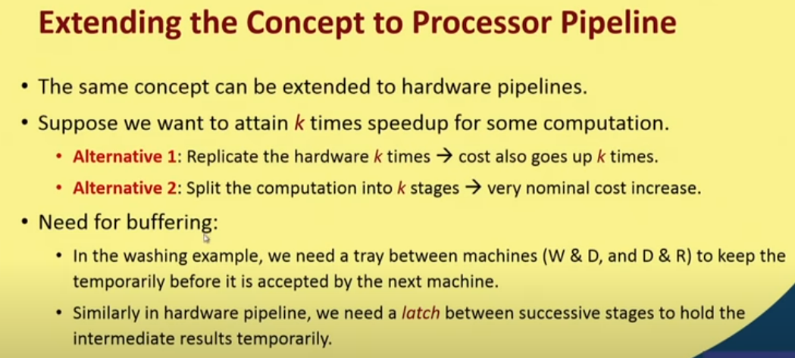

Slide 34
Pipeline Organization
Increases speed :
Most instructions executed in single cycle
Versions:
3-stage (ARM7TDMI and earlier)
5-stage (ARMS, ARM9TDMI)
6-stage (ARM10TDMI)
8-stage(ARM 11)
Notes:
Pipeline is the mechanism used by the RISC processor to execute instructions at an increased speed. This pipeline mechanism speeds up execution by fetching the next instruction while other instructions are being decoded and executed

Slide 35
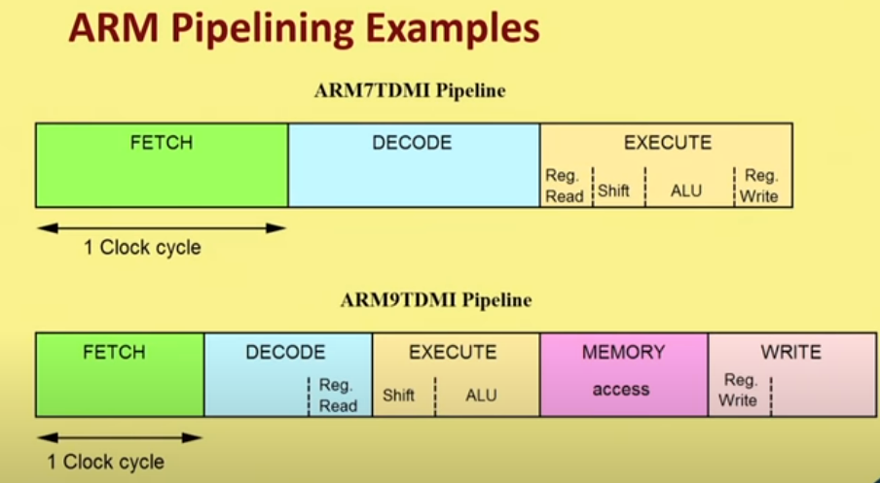

Slide 36
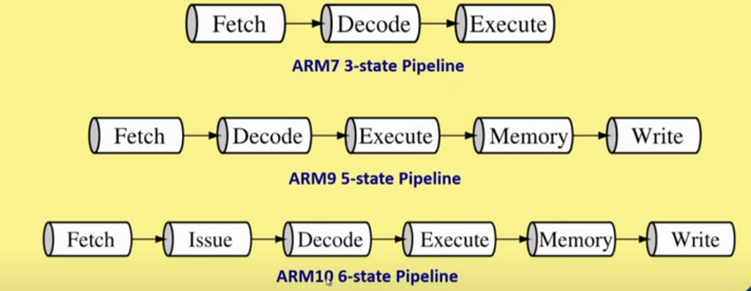

Slide 37
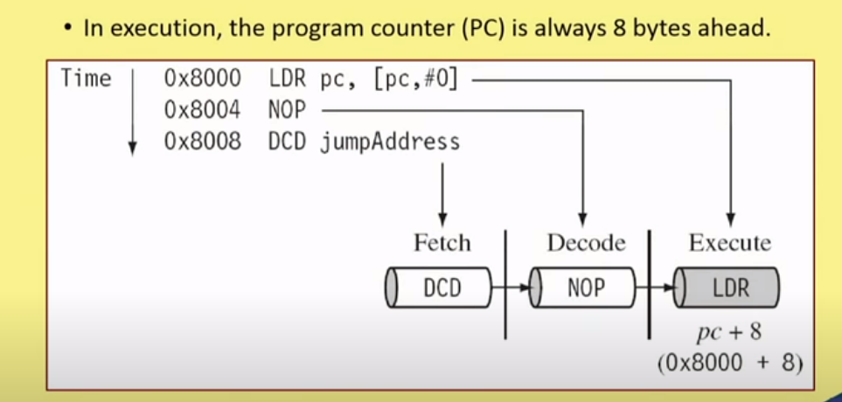

Slide 38
3-Stage Pipeline
ARM 7

Slide 39
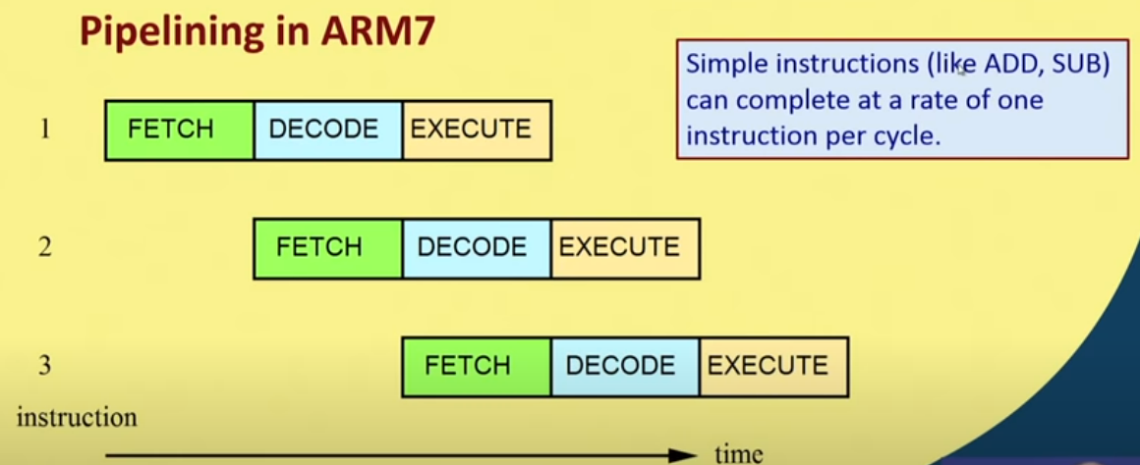

Slide 40
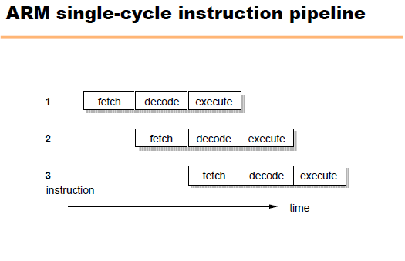
Latency: 3 cycles
Throughput: 1 instruction/cycle

Slide 41
Pipeline Organization
3-stage pipeline: Fetch – Decode - Execute
Three-cycle latency, one instruction per cycle throughput
instruction
i
Fetch
Decode
Execute
i+1
Fetch
Decode
Execute
i+2
Fetch
Decode
Execute
cycle
t
t+1
t+2
t+3
t+4
Notes:
During the execution of an instruction ,the processor Fetches the instruction .It means loads an instruction from memory. And decodes the instruction i.e identifies the instruction to be executed and finally Executes the instruction and writes the result back to a register

Slide 42
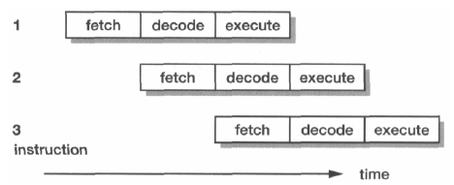
STAGES:
Fetch
Instruction taken from memory
Decode
Decode the fetched instruction and generate control signals for next cycle
Execute
Read register bank (shift if necessary)
ALU result generated
Write back to register

Slide 43
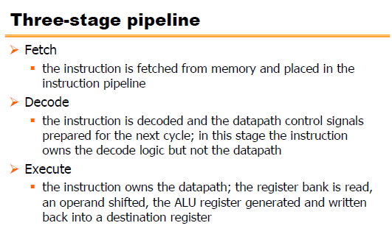

Slide 44
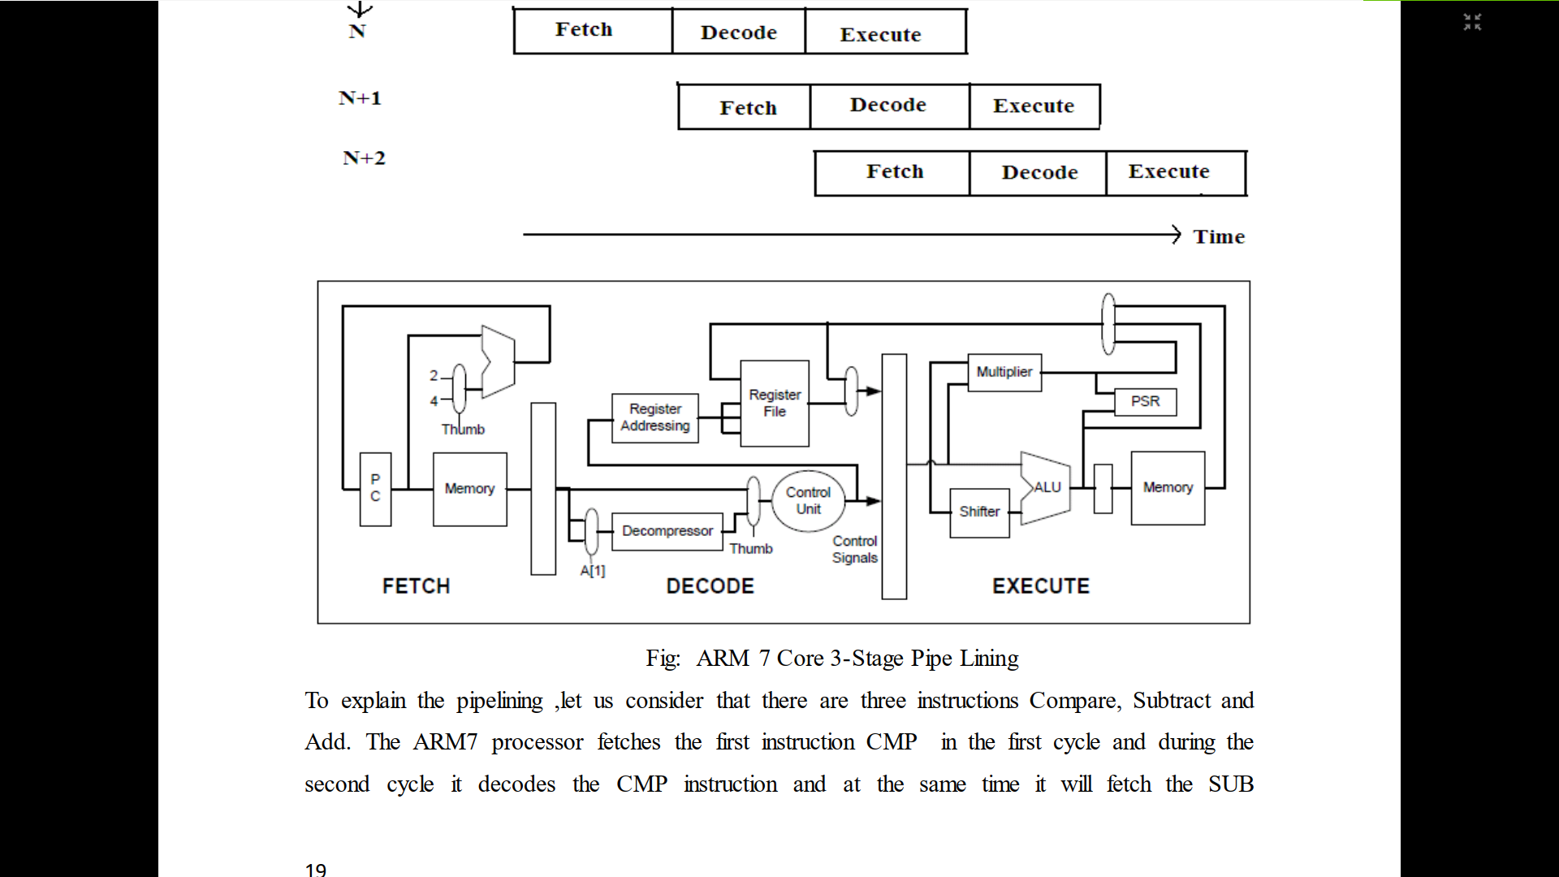
Notes:
Reference :PDF shared for ARM Intro – ARM processors Architecture

Slide 45
3-stage Pipeline ARM
Register bank
2 data write
1 data read
1 PC write
1 PC read
Shifter, ALU, Address register, incrementer, data registers, Decode & control logic
Notes:
Explanation in Furber

Slide 46
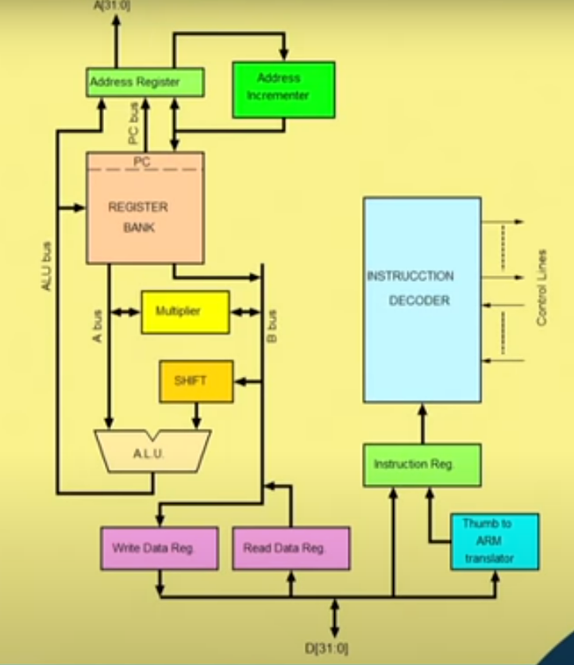
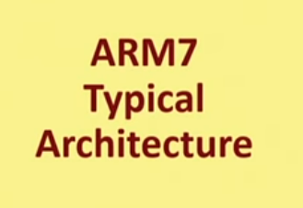

Slide 47
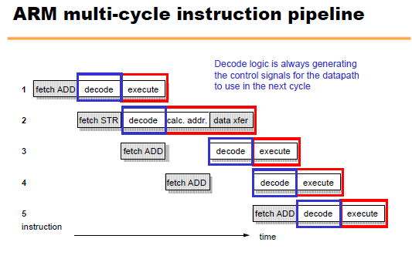
Notes:
Explanation given

Slide 48
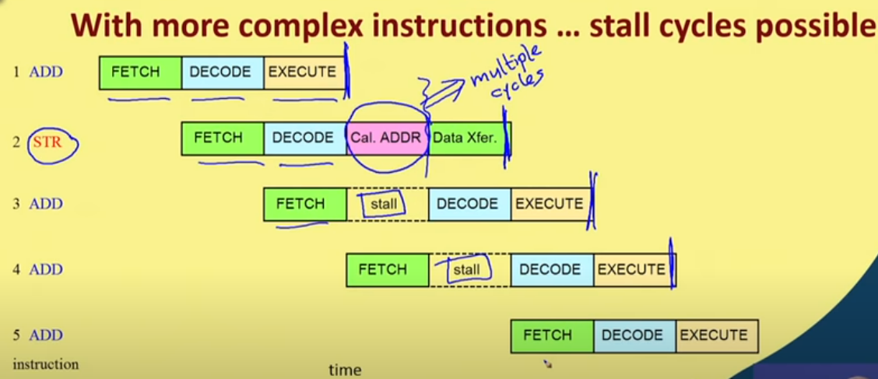

Slide 49
Five stage Pipelining
ARM9TDMI

Slide 50
Pipeline Organization
5-stage pipeline:
Reduces work per cycle =>
allows higher clock frequency
Separates data and instruction memory => reduction of CPI (average number of clock Cycles Per Instruction)
Stages:
Fetch
Decode
Execute
Buffer/data
Write-back

Slide 51
Pipeline Organization
Pipeline flushed and refilled on branch,
causing execution to slow down
Special features in instruction set
eliminate small jumps in code
to obtain the best flow through pipeline

Slide 52
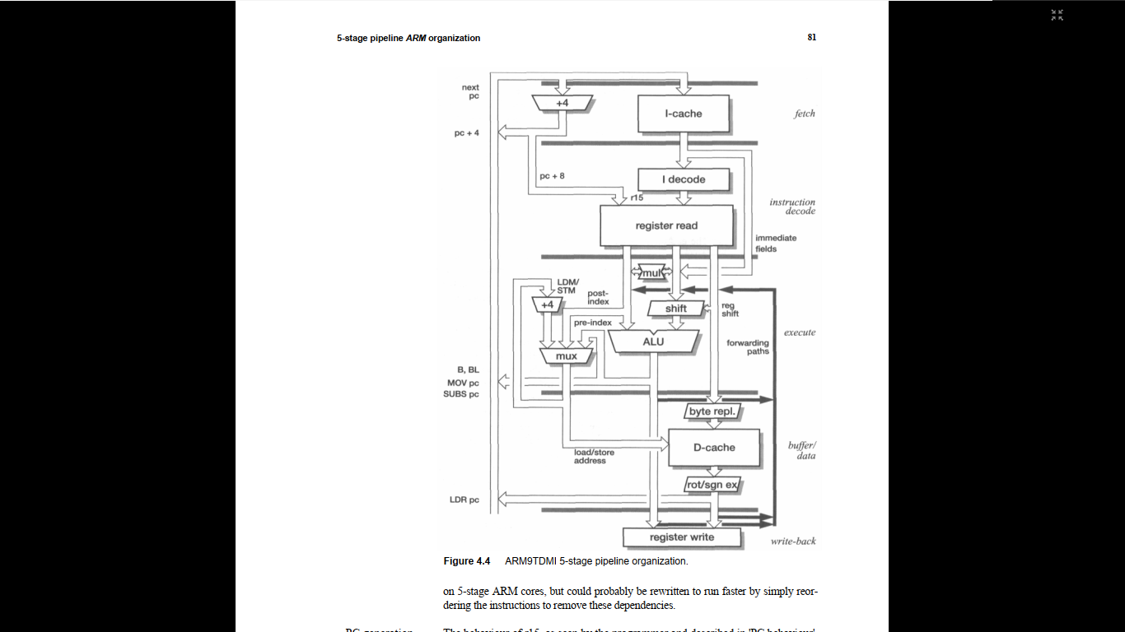

Slide 53
Thank You!
References:
Text books: Steve Furber, ARM System On Chip Architecture, Addison Wesley, 2000
https://youtu.be/3OmyM4zuQw?list=PLbRMhDVUMngcJu5oUhgpgYqtOn7DmSfuU
https://youtu.be/CuuIBvHrvtA?list=PLbRMhDVUMngcJu5oUhgpgYqtOn7DmSfuU
https://youtu.be/2RDtt8bysZE?list=PLbRMhDVUMngcJu5oUhgpgYqtOn7DmSfuU
Lyla B.Das, Embedded Systems an Integrated Approach, Pearson
https://www.makeuseof.com/tag/what-is-an-arm-processor/
https://en.wikipedia.org/wiki/ARM_architecture
https://www.watelectronics.com/arm-processor-architecture-working/

